Slide 1
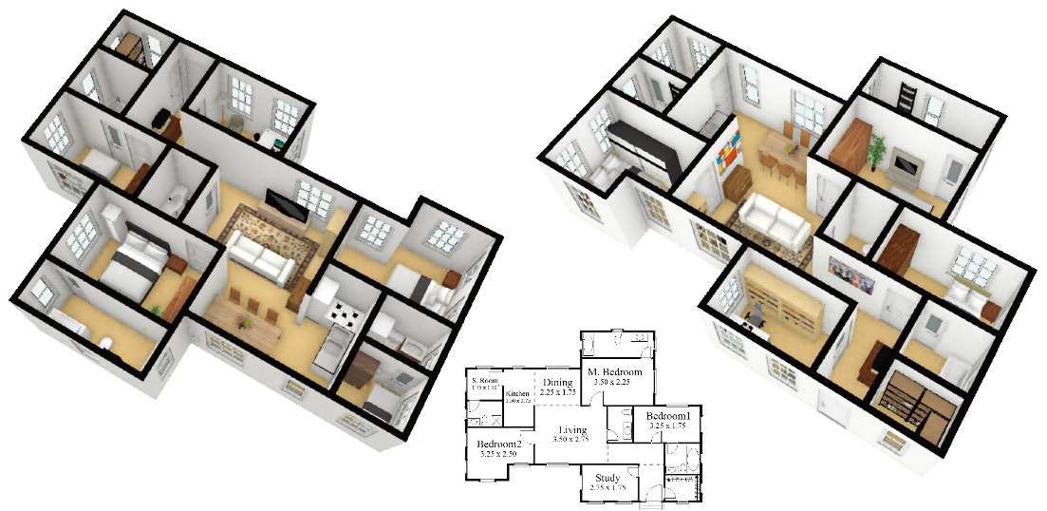
MIQP-based Layout Design for Building Interiors
Wenming Wu^{1,2}, Lubin Fan², Ligang Liu¹, Peter Wonka²
¹ University of Science and Technology of China, China
² King Abdullah University of Science and Technology, Saudi Arabia
Notes:
Good morning everyone.
Thank you so much for coming to my talk.
My name is Wenming Wu. Today I will present our work titled “MIQP-based Layout Design for Building Interiors” here.

Slide 2
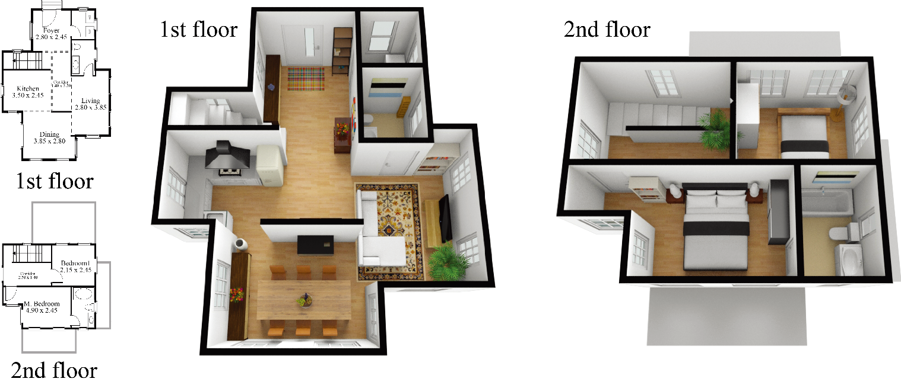
Outline
Motivation & Related work
Basic algorithm
Hierarchical algorithm
Results & Conclusions
Notes:
First, I will introduce the motivation of our work and show some related work.

Slide 3
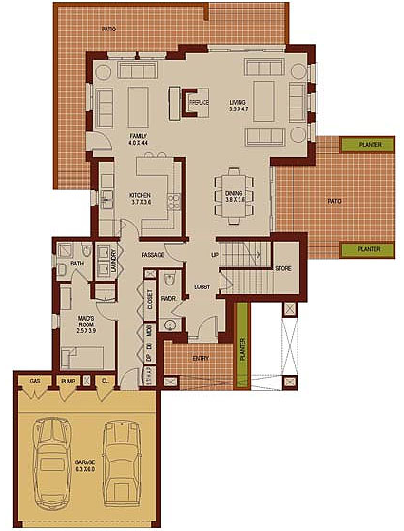
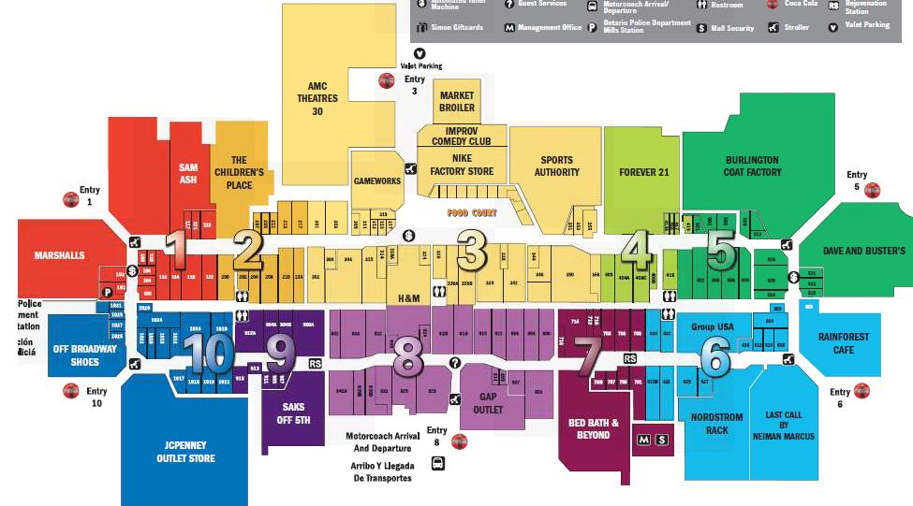
Motivation
Building layouts in the real-world
Notes:
This research addresses the problem of layout computation.
We are particularly interested in real-world building layouts,
such as residential building layouts and floorplans of large publicly accessible buildings.

Slide 4

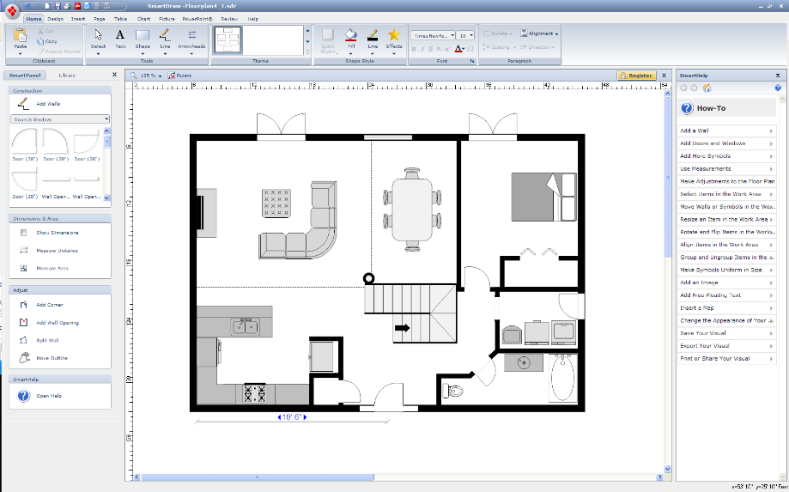
Motivation
Automatic generation
Architectural layout design in the real-world
Notes:
Traditionally, architectural layouts are designed using interactive design software.
It’s an iterative trial-and-error process that requires significant expertise, experience, and intuition.
In addition, it’s a time-consuming process that usually takes from a couple of days to several weeks.
In this work, we would like to automate a part of the design process, by computing layouts from a set of given constraints and objectives.

Slide 5
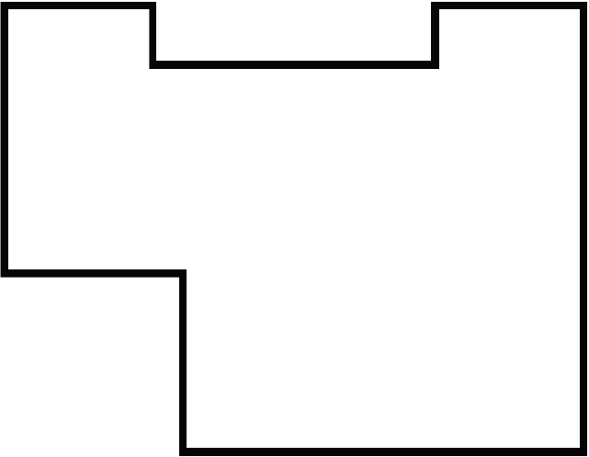
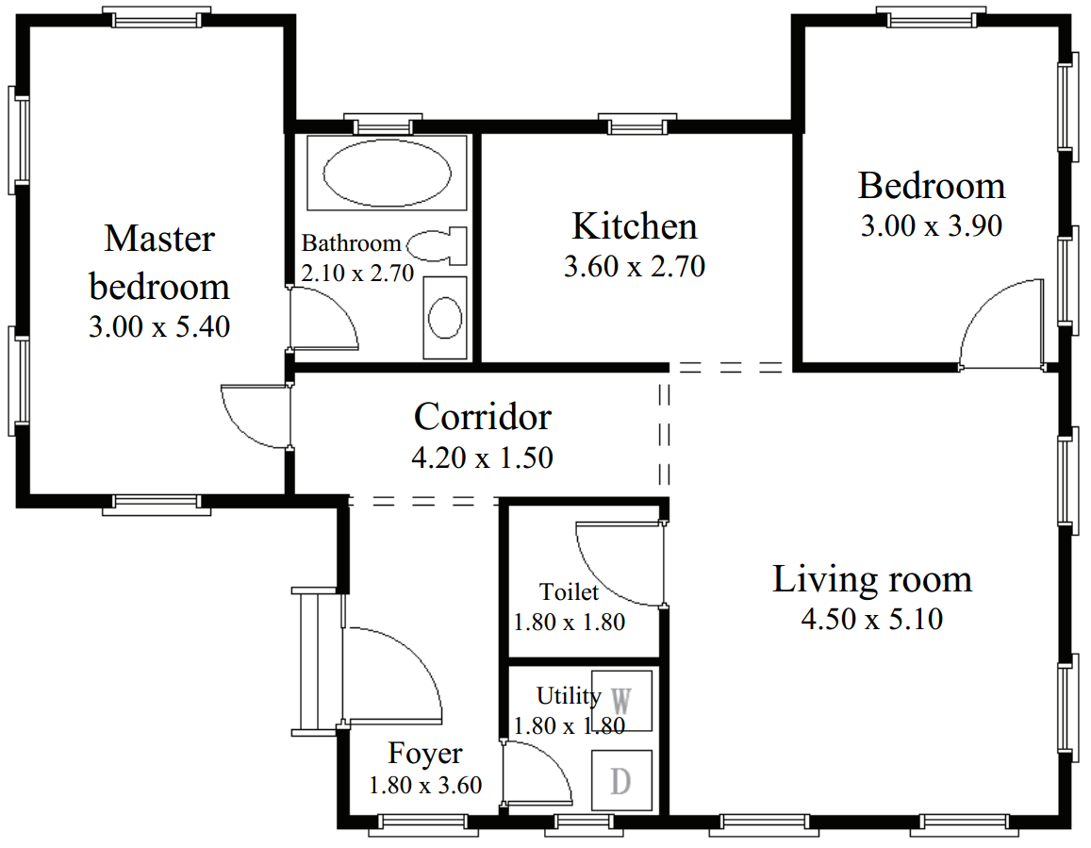
Problem statement
Size constraint
Aspect ration constraint
Boundary constraint
Adjacency constraint
……
Notes:
We reiterate our problem statement as follows.
Given an outline and a list of high-level constraints, such as size constraint, aspect ratio constraint, boundary constraint and adjacency constraint as input ,
how to generate an interior layout satisfying these constraints?

Slide 6
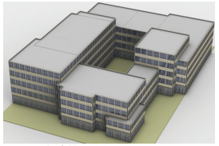
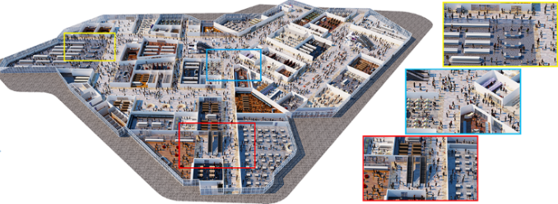
Related work
Architectural floorplan design
Stochastic method [Merrell et al. 2010]
Component-based [Leblanc et al. 2011]
Constraint, concrete-based [Liu et al. 2013]
Layout exploring [Bao et al. 2013]
……
Urban layout modeling
Hierarchical splitting [Yan et al. 2013]
Tiling-based [Peng et al. 2014]
Network design [Peng et al. 2016]
Crowd-driven [Feng et al. 2016]
……
[Bao et al. 2013]
[Feng et al. 2016]
Notes:
The problem of floor plan computation can be posed as designing the room layout of a building starting from the property boundaries
or the building mass model or footprint. And urban layout modeling can be seen as an extension of the architectural floorplan design.
While there is a lot of work on layout computation in computer graphics, only a few papers offer a solution to the core problem.

Slide 7
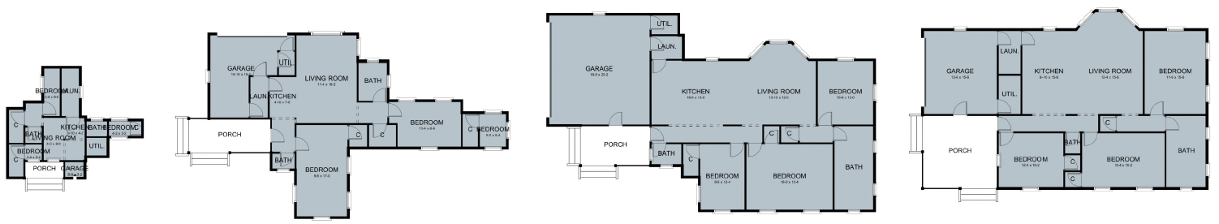
Related work
Computer-generated residential building layouts
[Merrell et al. 2010]
200
iterations
2,000
iterations
20,000
iterations
100,000
iterations
Scalability
problem
Stochastic method
Notes:
Merrell’s work is most relevant to our work.
They use a stochastic method to synthesize a layout. In general, stochastic search is the most popular approach in layout optimization.
The main problem of this approach is the scalability problem. It is not suitable for large-scale layouts.

Slide 8
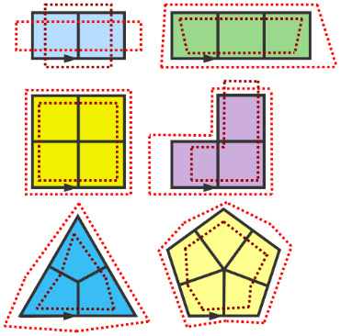
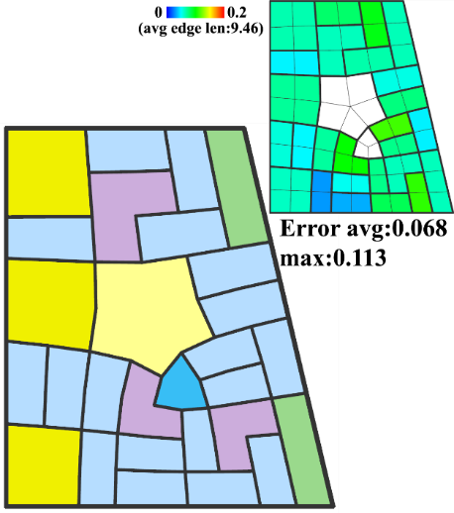
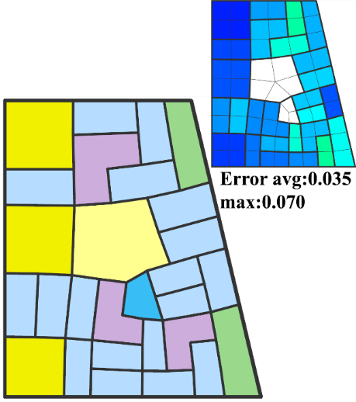
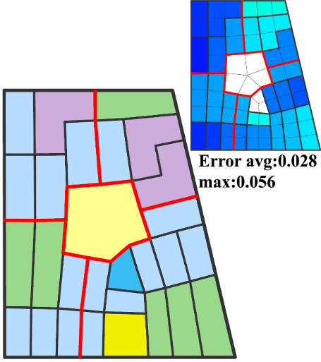
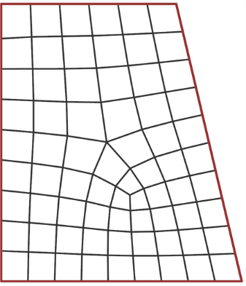
Related work
Computing layouts with deformable templates
[Peng et al. 2014]
Only pre-defined templates
Tiling-based method
Notes:
The layout optimization method should be powerful enough to solve large-scale layout problems.
Peng’s work applies linear integer programming to generate urban layouts with deformable templates.
Their tilling-based approach can scale better to large-scale layouts.
However, they can only use pre-defined room templates.

Slide 9
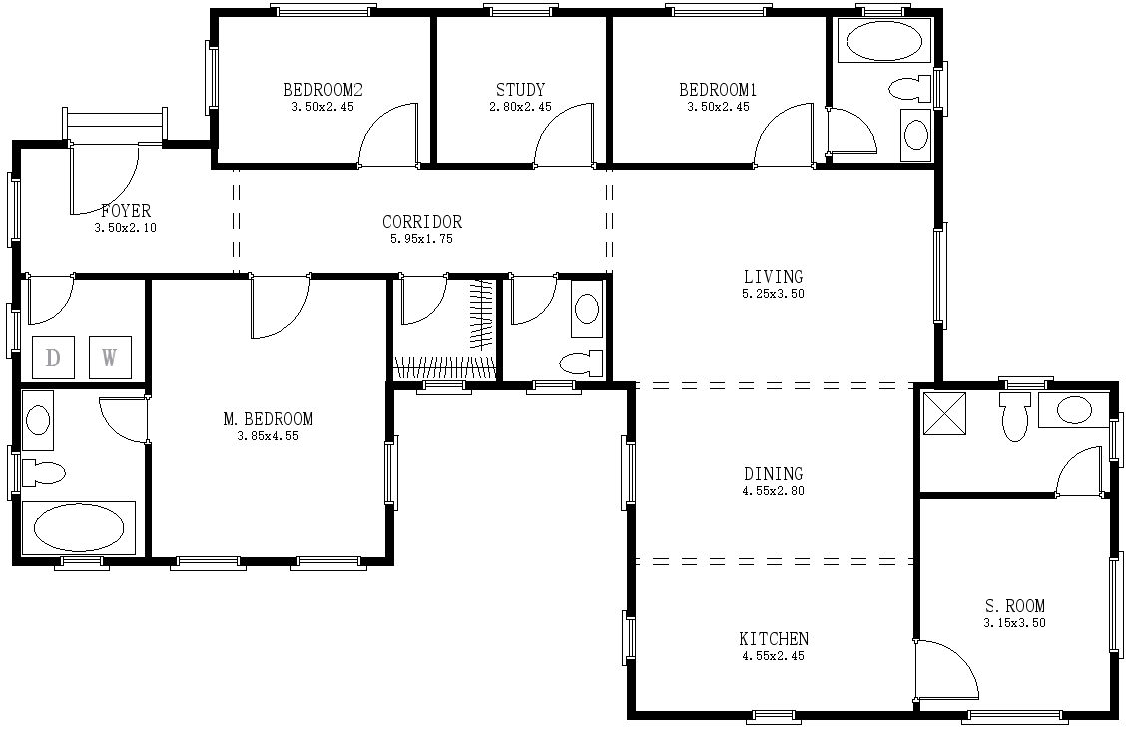
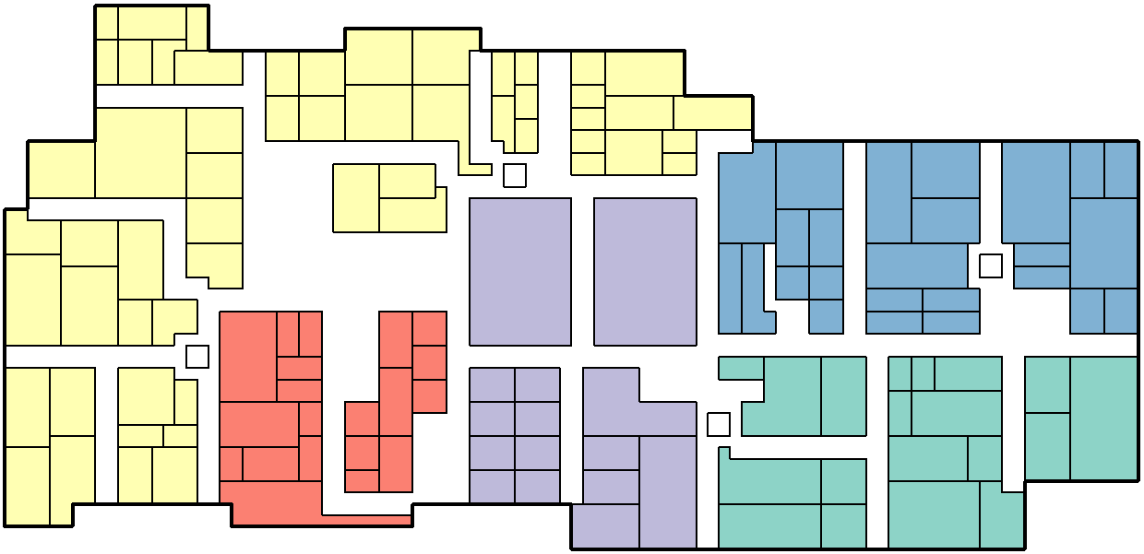
Our Work
MIQP-based method
(mixed integer quadratic programming)
Scalability problem of stochastic methods
Restriction problem of the tiling-based methods
Notes:
We formulate the layout optimization problem as a mixed integer quadratic programming problem, called MIQP-based optimization.
We propose a layout computation method that overcomes both the scalability problem of stochastic methods
and the restriction problem of the tiling-based approaches at the same time.

Slide 10
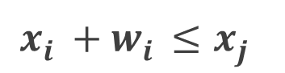
Mixed Integer Quadratic Programming
Non-overlap constraint
LP
j
i
(
x ,y ,w ,d
)
j
j
j
j
(
x ,y ,w ,d
)
i
i
i
i
$$x_{i}^{}{+ w}_{i}^{}≤x_{j}^{}$$
Notes:
Linear Programming or Quadratic Programming is very good to handle the continuous aspect of the layout problem.
For example, the non-overlap constraint can be easily formulated, if we know the relative relationship of two rooms.
In this example, we know that the room i is to the left of the room j.
However, the difficulty of formulating the non-overlap constraint during the layout optimization is that we have no prior knowledge of which case to use.
So we need a formulation to encode all four discrete options at once. This is where discrete or integer variables can help.

Slide 11
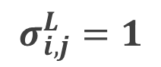
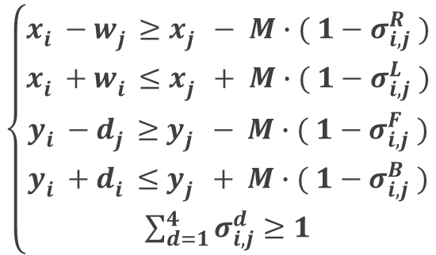
Mixed Integer Quadratic Programming
Non-overlap constraint
LP
MIQP
j
j
i
i
(
(
x ,y ,w ,d
)
x ,y ,w ,d
)
j
j
j
j
j
j
j
j
(
(
x ,y ,w ,d
)
x ,y ,w ,d
)
i
i
i
i
i
i
i
i
$$\left\{\begin{aligned}{x_{i}^{}{− w}_{j}^{}≥x_{j}^{}− M∙( 1−σ_{i,j}^{R} ) \atop x_{i}^{}{+ w}_{i}^{}≤x_{j}^{}+ M∙( 1−σ_{i,j}^{L} )} \\ {y_{i}^{}{− d}_{j}^{}≥y_{j}^{}− M∙( 1−σ_{i,j}^{F} ) \atop \begin{aligned}y_{i}^{}{+ d}_{i}^{}≤y_{j}^{}+ M∙( 1−σ_{i,j}^{B} ) \\ \sum_{d=1}^{4}{σ_{i,j}^{d}≥1}\end{aligned}}\end{aligned}\right.$$
$$x_{i}^{}{+ w}_{i}^{}≤x_{j}^{}$$
binary variable
$$σ_{i,j}^{L}=1$$
Notes:
This is our solution to the problem. We introduce four binary variables to represent four possible relationships between two rooms.
For the same case on the left, we only need that the binary variable $σ_{i,j}^{L}$ equals to 1.
Here the big M is a large constant to ensure there is no overlap between two rooms in a certain direction when the corresponding binary variable equals to 1,
and the inequality is always established when the corresponding binary variable equals to 0.
The power of MIQP is that it can assign variables to choose between discrete options in the solver.
and therefore explore a huge number of discrete configurations in the solver.

Slide 12
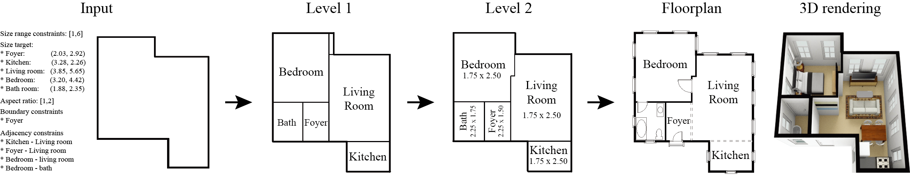
Overview
Constraints:
- Room size
- Room position
- Room adjacency,
etc.
Input：high-level constraints and outline
Level 1：initial layout
Level 2：local refinements
Output：floorplan
Notes:
Let’s take a look at the overview of our method.
We propose a framework that generates a floorplan given an outline and high-level constraints,
such as room size, room position and room adjacency.
Level 1 shows an initial layout and Level 2 shows the layout including local refinements.

Slide 13
Outline
Motivation & Related work
Basic algorithm
Hierarchical algorithm
Results & Conclusions
Notes:
Now let me explain the basic algorithm of our approach.

Slide 14
Layout representation
Interior Layout
r
r
1
6
r
r
Bedroom
2
3
r
r
4
5
Notes:
We propose a parametric layout representation of interior layouts that is more general than previous methods.
The layout of a building consists of its domain given as an axis-aligned polygon and rooms.
The domain and each room are defined by an array of vertices.

Slide 15
Layout representation
Interior Layout
Parametric Representation
r
r
1
6
r
r
Bedroom
Bedroom
2
3
(
x ,y ,w ,d ,l
)
r
r
i
i
i
i
i
4
5
Notes:
To make the model better suitable for optimization, we introduce the computational objects called room rectangles which are the basic elements of a layout.
A polygonal room can be represented as the union of a set of room rectangles with the same label.
Given the layout domain, the goal of the layout design problem is to arrange a set of room rectangles inside of the domain according to some constraints.

Slide 16
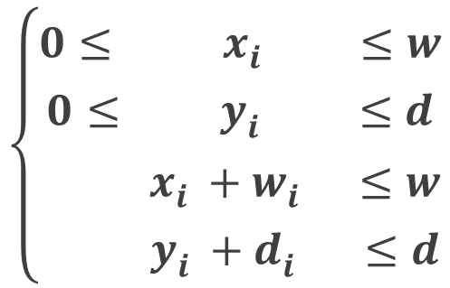
Basic Formulation
Inside constraint
w
d
(
x ,y ,w ,d
)
i
i
i
i
$$\left\{\begin{aligned}{0≤{ x}_{i}^{} ≤w \atop 0≤{ y}_{i}^{} ≤d} \\ {{ x}_{i}^{}{+ w}_{i}^{} ≤w \atop y_{i}^{}{+ d}_{i}^{} ≤d}\end{aligned}\right.$$
Notes:
We introduce our algorithm starting from the simplest case in which both the layout domain and rooms are rectangles.
We consider the layout to be valid if it satisfies two basic constraints.
The inside constraint ensures that all rooms are inside of the boundary.

Slide 17
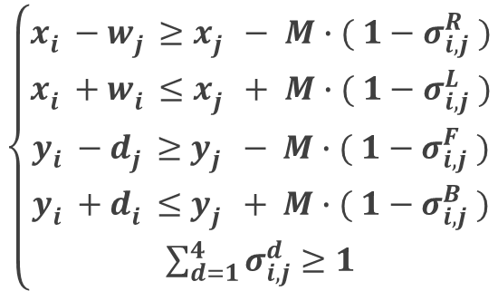
Basic Formulation
Non-overlap constraint
(
x ,y ,w ,d
)
j
j
j
j
(
x ,y ,w ,d
)
i
i
i
i
$$\left\{\begin{aligned}{x_{i}^{}{− w}_{j}^{}≥x_{j}^{}− M∙( 1−σ_{i,j}^{R} ) \atop x_{i}^{}{+ w}_{i}^{}≤x_{j}^{}+ M∙( 1−σ_{i,j}^{L} )} \\ {y_{i}^{}{− d}_{j}^{}≥y_{j}^{}− M∙( 1−σ_{i,j}^{F} ) \atop \begin{aligned}y_{i}^{}{+ d}_{i}^{}≤y_{j}^{}+ M∙( 1−σ_{i,j}^{B} ) \\ \sum_{d=1}^{4}{σ_{i,j}^{d}≥1}\end{aligned}}\end{aligned}\right.$$
Notes:
The second one is the non-overlap constraint. We have discussed this constraint in the first part, and we skip it here.

Slide 18
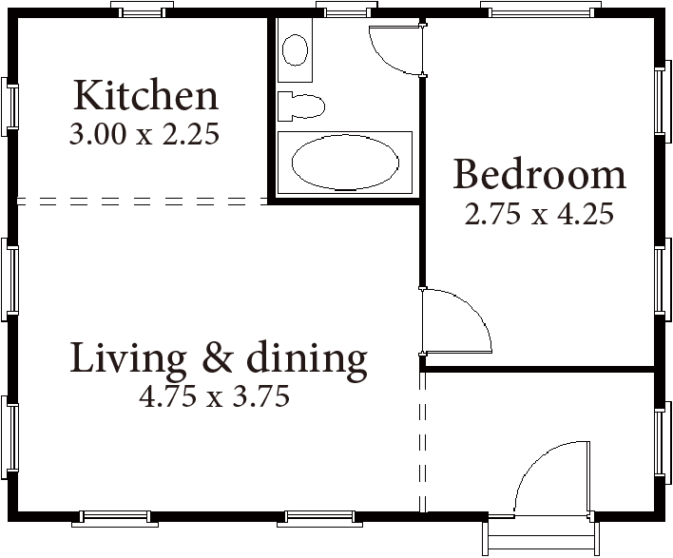

Basic Formulation
$$E_{cover}^{}\left(L\right)=Area\left(L\right)−\sum_{i}{w_{i}^{}×d_{i}^{}}$$
Notes:
We call layouts that satisfy the constraints "valid layouts" and our objective function specifies that we prefer layouts that cover the domain as much as possible.
This is our basic formulation, and minimizing this MIQP objective function with linear constraints, we obtain a layout from the basic formulation.

Slide 19
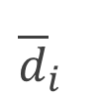
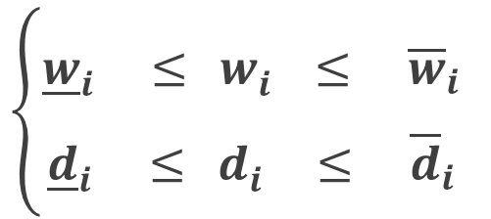
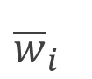

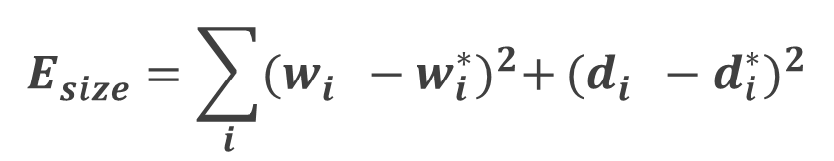

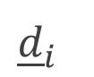

High-level constraints
Size control
$${\overline{w}}_{i}^{}$$
$$\left\{\begin{aligned}{\underline{w}}_{i}^{} ≤{ w}_{i}^{} ≤ {\overline{w}}_{i}^{} \\ {\underline{d}}_{i}^{} ≤{ d}_{i}^{} ≤ {\overline{d}}_{i}^{}\end{aligned}\right.$$
$$w_{i}^{}$$
$${\overline{d}}_{i}^{}$$
$${\underline{w}}_{i}^{}$$
$$d_{i}^{}$$
$$E_{size}^{}=\sum_{i}{{(w_{i}^{}−w_{i}^{∗})}^{2}+}{(d_{i}^{}−d_{i}^{∗})}^{2}$$
$${\underline{d}}_{i}^{}$$
Target sizes
Notes:
We also model five optional high-level constraints. The first one is size control.
The range of the room size can be constrained by providing the minimum and maximum values of width and depth.
The user can also specify target sizes for each room.
We compute the size error of rooms for the optimization.

Slide 20
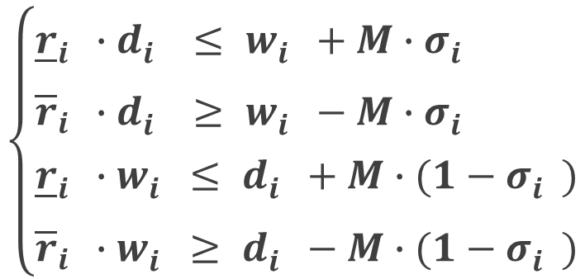


High-level constraints
Aspect ratio constraint
Auxiliary binary variable
{horizontal or vertical room}
$$w_{i}^{}$$
Aspect
ratio
range
$$\left\{\begin{aligned}&{\underline{r}}_{i}^{}∙d_{i}^{} ≤ w_{i}^{}+M∙σ_{i}^{} \\ &{\overline{r}}_{i}^{}∙d_{i}^{} ≥ w_{i}^{}−M∙σ_{i}^{} \\ &{\underline{r}}_{i}^{}∙w_{i}^{}≤ d_{i}^{}+M∙(1−σ_{i}^{}) \\ {\overline{r}}_{i}^{}∙w_{i}^{}≥ d_{i}^{}−M∙{(1−σ}_{i}^{})\end{aligned}\right.$$
$$d_{i}^{}$$
Notes:
We provide the room aspect-ratio constraint to avoid generating rooms that are too wide or too narrow.
We set the minimum and maximum aspect ratios between width and depth.
we add a binary variable for each room to distinguish between the two possible orientations of the room rectangle..

Slide 21
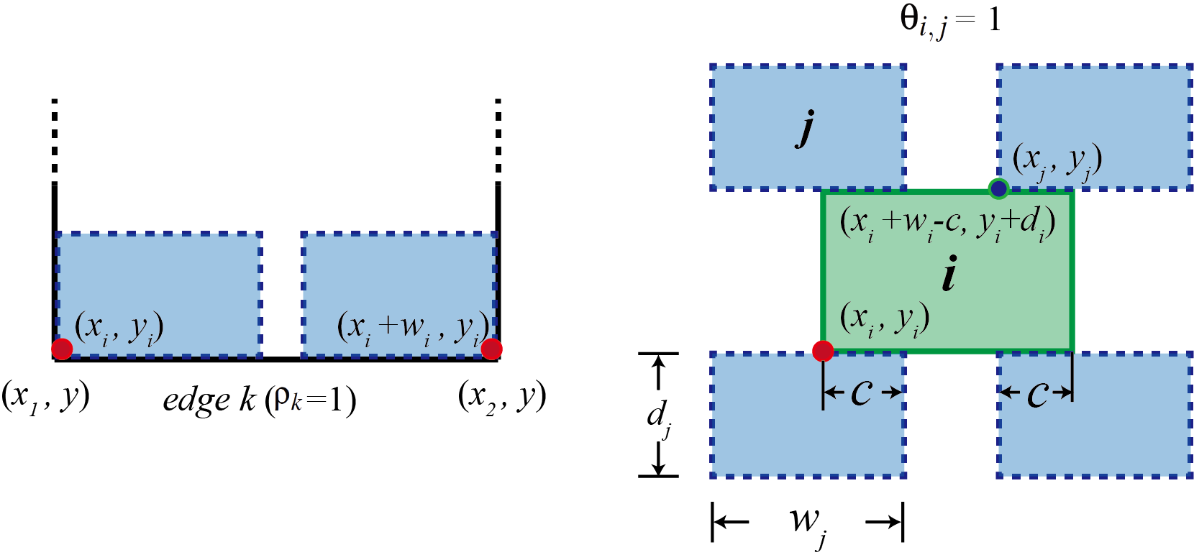
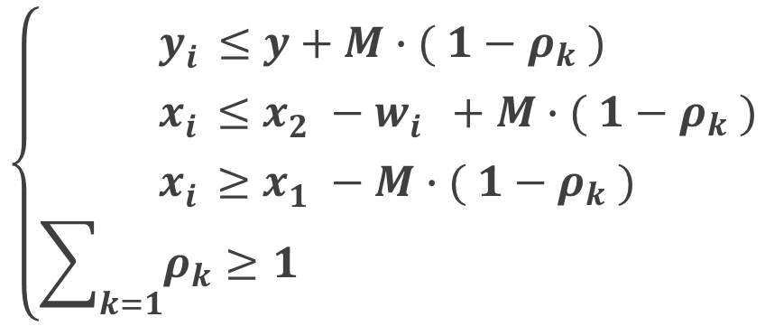
High-level constraints
Boundary constraint
Auxiliary binary variable
{adjacent to edge k or not}
$$\left\{\begin{aligned}&{ y}_{i}^{}≤y+M∙( 1−ρ_{k} ) \\ &{ x}_{i}^{}≤x_{2}^{}−w_{i}^{}+M∙( 1−ρ_{k} ) \\ &{ x}_{i}^{}≥x_{1}^{}−M∙( 1−ρ_{k} ) \\ &\sum_{k=1}{ρ_{k}≥1}&\end{aligned}\right.$$
Notes:
The position constraint requires the room to cover a single point or multiple points specified by the user.
We add a boundary constraint that requires the room to be adjacent to at least one of the user specified edges of the domain polygon.
Here, we suppose that the edge is a bottom edge, and we introduce a binary variable to indicate if that the room is adjacent to edge k or not.

Slide 22
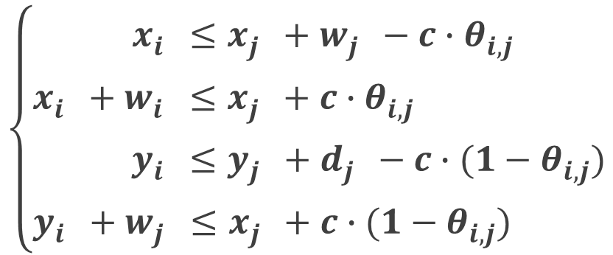
High-level constraints
Adjacency constraint
Auxiliary binary variable
{horizontal or vertical connection}
$$\left\{\begin{aligned}x_{i}^{}&≤x_{j}^{}+w_{j}^{}−c∙θ_{i,j}^{} \\ x_{i}^{}+w_{i}^{}&≤x_{j}^{}+c∙θ_{i,j}^{} \\ y_{i}^{}&≤y_{j}^{}+d_{j}^{}−c∙{(1−θ}_{i,j}^{}) \\ y_{i}^{}+w_{j}^{}≤x_{j}^{}+c∙{(1−θ}_{i,j}^{})\end{aligned}\right.$$
Contact length
Notes:
The user can also specify two rooms to be adjacent.
Here c is the contact length, the common edge between the two connected rooms.
The contact length is important to ensure that there is enough space for adding a door between two rooms.
We also have a binary variable that determines the connect direction automatically. The binary variable denotes a horizontal or vertical connection.

Slide 23
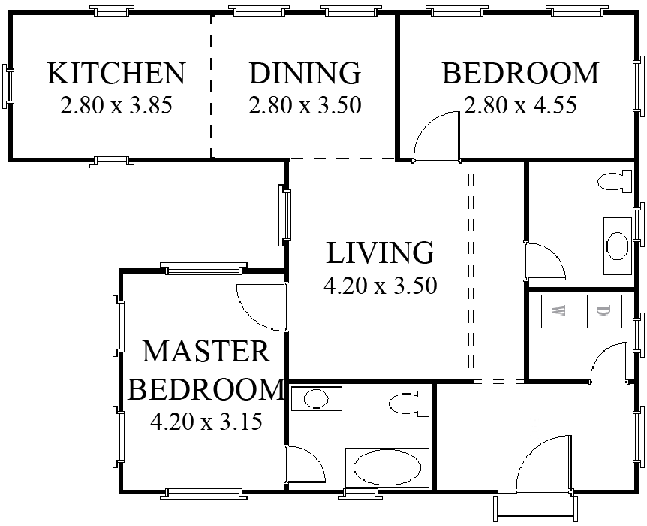
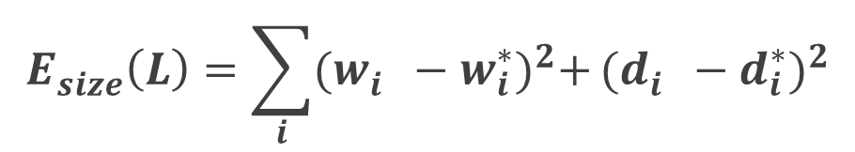

Object function
$$E={{λ_{cover}^{}E}_{cover}^{}\left(L\right)+λ_{size}^{}E_{size}^{}(L)}$$
$$E_{cover}^{}\left(L\right)=Area\left(L\right)−\sum_{i}{w_{i}^{}×d_{i}^{}}$$
$$E_{size}^{}\left(L\right)=\sum_{i}{{(w_{i}^{}−w_{i}^{∗})}^{2}+}{(d_{i}^{}−d_{i}^{∗})}^{2}$$
Notes:
The final objective function is defined as the combination of coverage term and size error term subject to a set of linear constraints expressed before.
Minimizing this MIQP objective function with several high-level constraints, we obtain a more complex and more real layout.

Slide 24
Outline
Motivation & Related work
Basic algorithm
Hierarchical algorithm
Results & Conclusions
Notes:
Next, I will introduce the hierarchical algorithm from the basic algorithm.

Slide 25
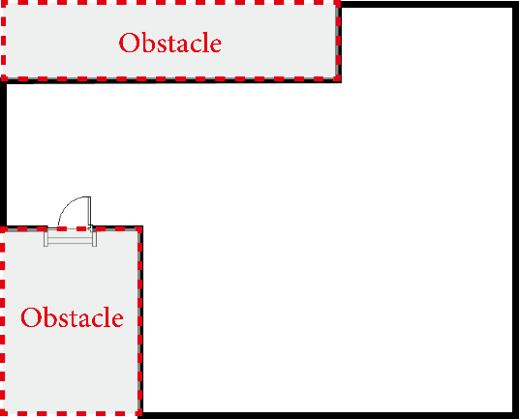
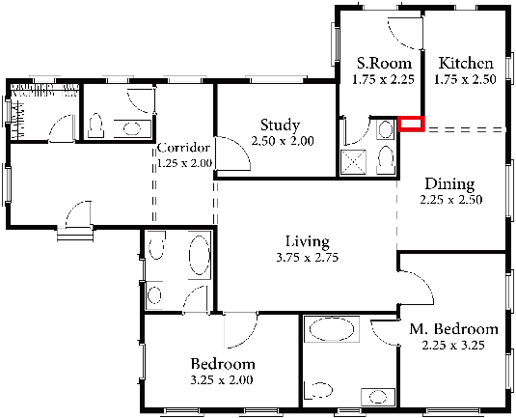
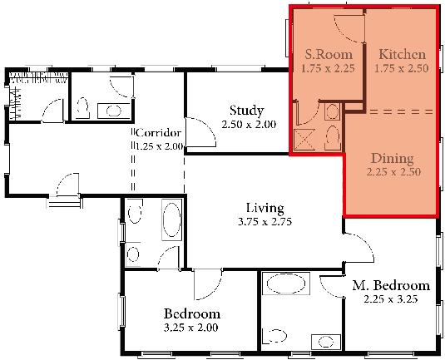
Hierarchical Framework
Input Layout Domain
Intermediate Result
Sub-domain Selection
Notes:
We propose a hierarchical framework to extend the basic method to improve the detail of each room.
Starting from the empty layout domain, and user-specified high-level constraints, we first generate an interior layout on the first level.
There is a red region that is not covered by any room, and we select the sub-region for further improvement.

Slide 26
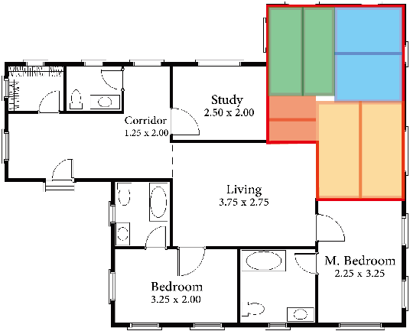
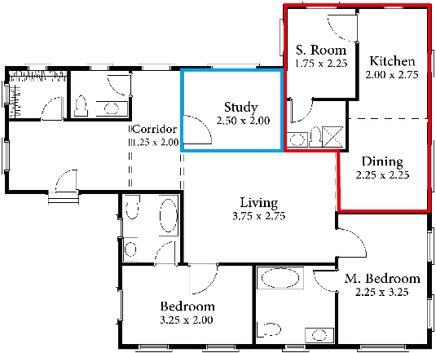
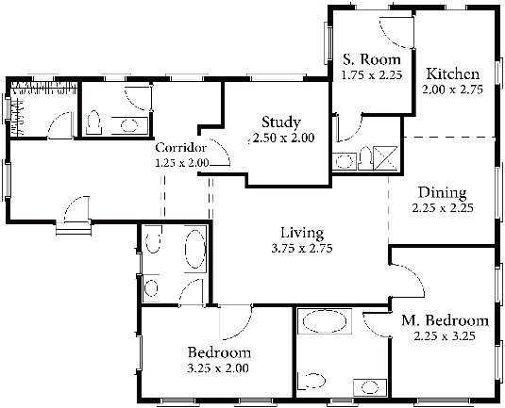
Hierarchical Framework
Initialization & Constraints Update
Intermediate Result
Final Result
Notes:
Then we initialize the layout optimization by separating rooms in the sub-domain.
The constraints for rectangular rooms in the subdomain are updated.
Then we apply the same method to generate the new layout in the sub-domain.
We repeat this procedure to get the final layout.

Slide 27
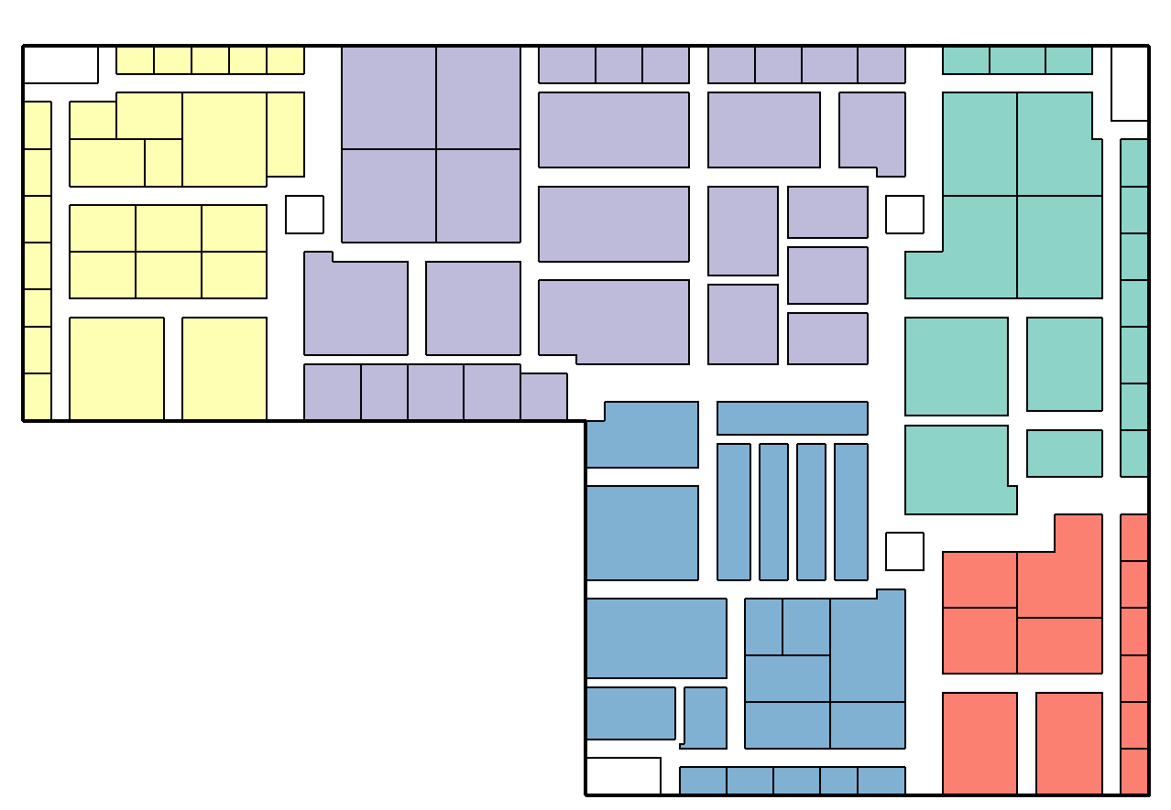
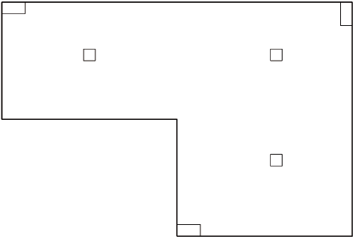
Large-scale layout generation
Obstacle
Notes:
We apply a hierarchical framework for large-scale layout generation.
Starting from an empty layout domain with obstacles,
We generate a layout of the shopping mall.

Slide 28
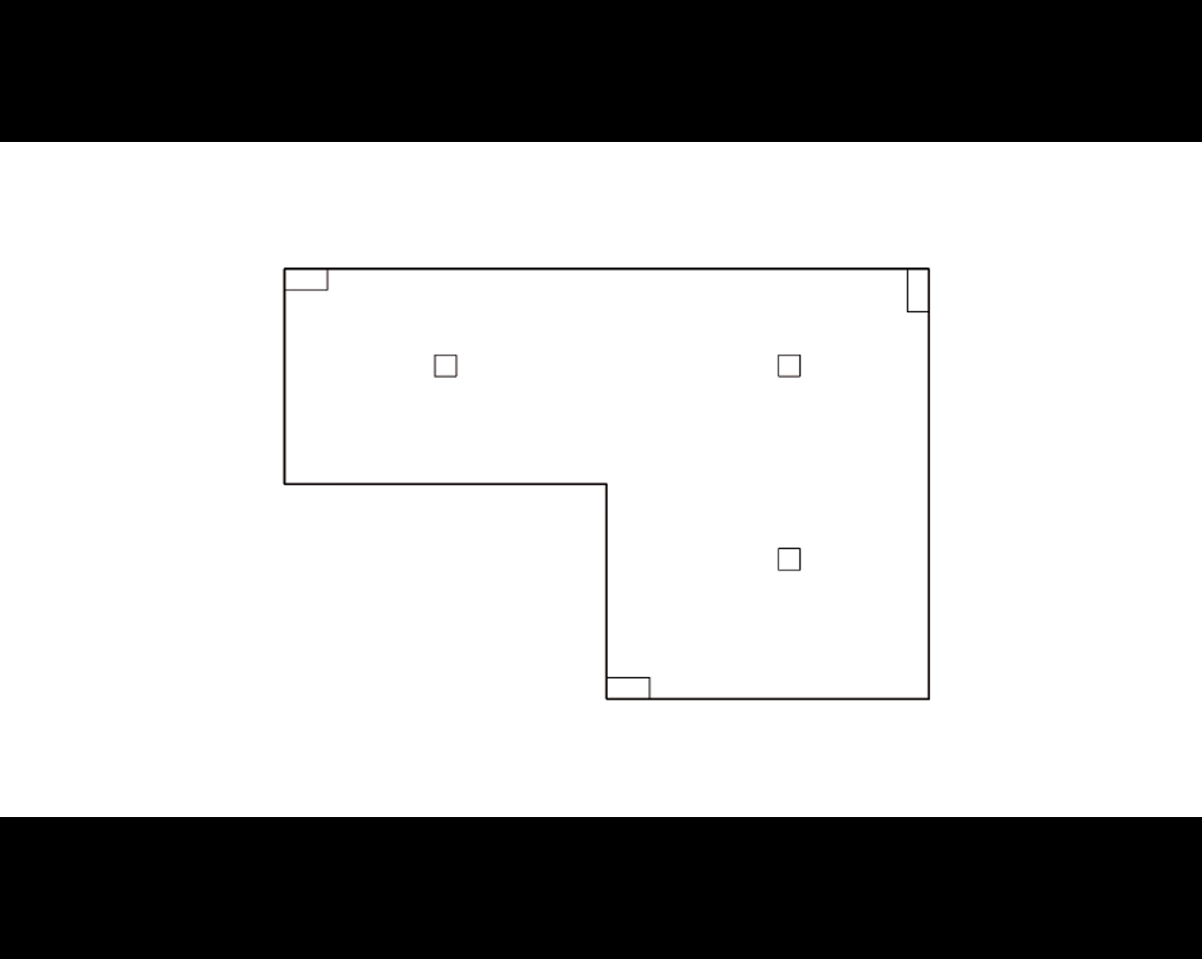
Large-scale layout generation
Notes:
Our main idea is to generate the layout for regions first, and then generate the layout inside each region.
Given the layout domain and constraints for regions, we apply the hierarchical framework to generate the layout for each region.
Here is the whole process of the generation.

Slide 29
Outline
Motivation & Related work
Basic algorithm
Hierarchical algorithm
Results & Conclusions
Notes:
Finally, I will show some results and present short conclusions.

Slide 30
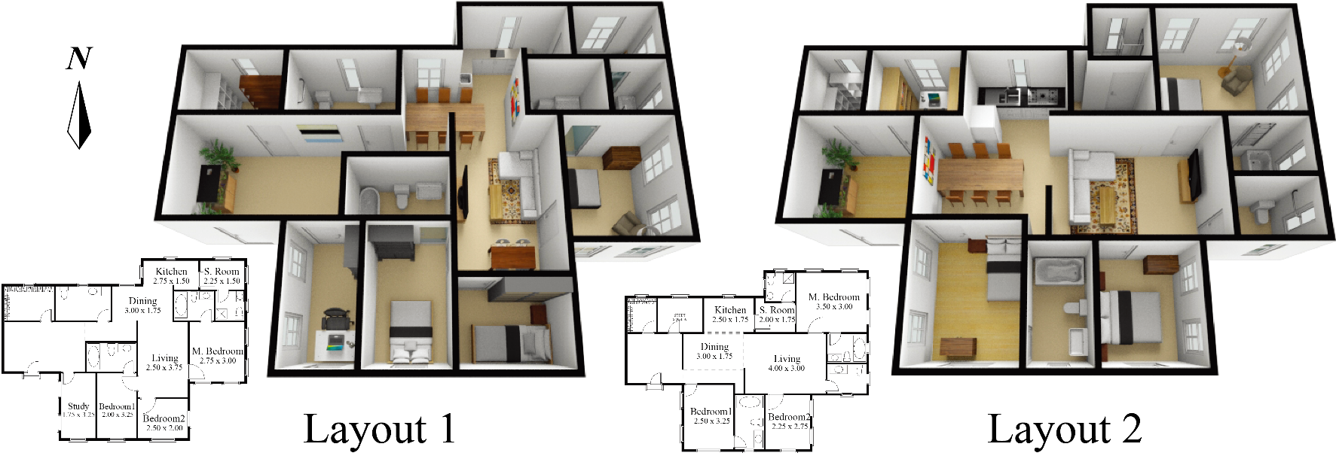
Results
Apartment
Notes:
Two apartment layouts are generated by our algorithm to show that we can generate different results for the same input.

Slide 31
Results
Bungalow-style house
Notes:
An interior layout of a bungalow-style house is generated by our algorithm.

Slide 32
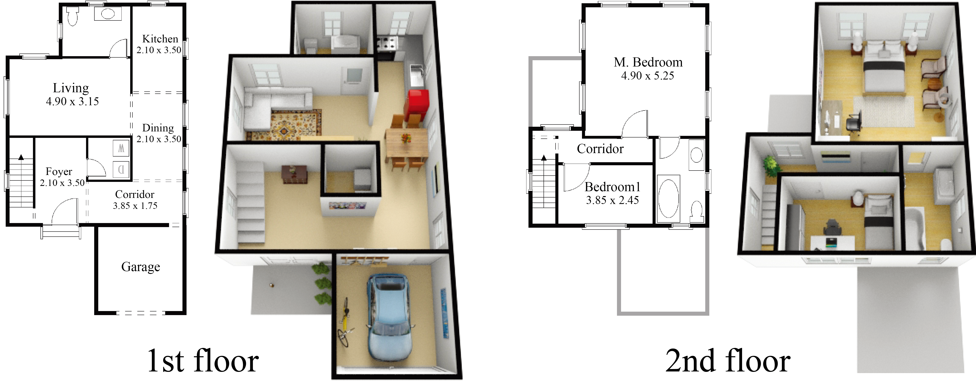
Results
Multi-story house
Notes:
This is an example of a two-story house.

Slide 33
Results
Office building
Notes:
We also test our method on large-scale examples, such as office building.

Slide 34
Results
Shopping mall
Notes:
Shopping mall，

Slide 35
Results
Supermarket
Notes:
And supermarket.

Slide 36
Comparisons
Our method
Stochastic Method
Notes:
We perform a comparison with stochastic optimization used in previous work. Here are layouts generated by our method and the stochastic method.
The stochastic method took 10 times longer than our method in this test.
Still, for the layout generated by the stochastic method, there is a small region not covered by any room, and there are several rooms too small to add furniture.

Slide 37
Comparisons
Notes:
This is the performance comparison between the stochastic method and ours.
For the stochastic method, the running time increases significantly when the complexity of the problem increases.
According to the comparison, for large-scale layouts, our method is multiple orders of magnitude faster than the stochastic method.

Slide 38
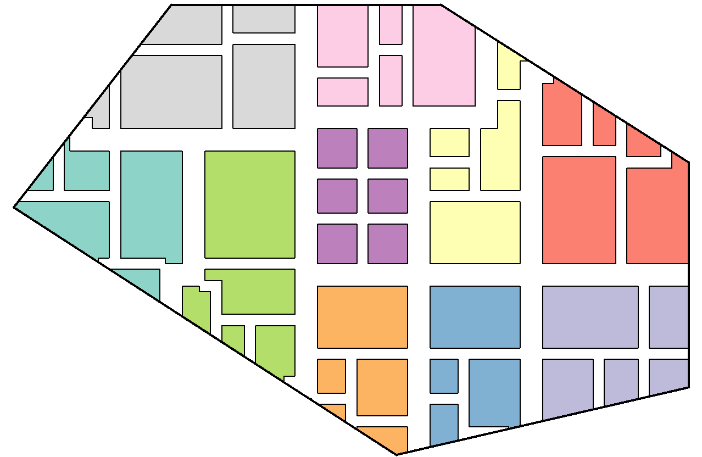
Limitation
Non axis‐aligned layout
Notes:
Although our approach works well in general, it does have some specific limitations that suggest areas for future work.
We cannot handle non axis‐aligned polygons in the current stage.
One possible approach is to apply shape deformations to generate rooms in arbitrary shapes.

Slide 39
Conclusions
A layout computation method that is much faster than previous work built on stochastic optimization
A parametric representation of interior layouts that is more general than previous methods built on tiling
Building interiors on a larger scale than previous work
Notes:
In conclusion, we propose a layout computation method that is much faster than previous work built on stochastic optimization.
We propose a parametric representation of interior layouts that is more general than previous methods built on tiling.
We can generate larger scale layouts than previous work.

Slide 40
Thanks!
Notes:
Thanks for your attention.

Slide 41
Acknowledgements
Funding agencies:
KAUST Office of Sponsored Research (OSR) under Award No. OCRF-2014-CGR3-62140401
The Visual Computing Center at KAUST
National Natural Science Foundation of China (61070071,
61672481, 11626253)
The One Hundred Talent Project of the Chinese Academy of Sciences
Notes:
We would like to thank these funding agencies for their contribution to this project.
Now I am pleased to answer your questions.

